Slide 1

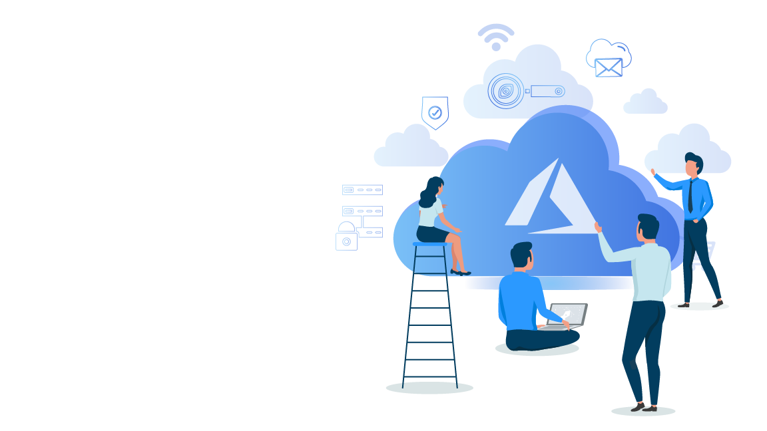

Microsoft Azure Administrator Associate Training(AZ-103)
Module 5

Slide 2
Agenda
01
05
Create Internal Load Balancer
09
Why Azure Network Watcher?
Azure Load Balancer
02
Load Balancer Concepts
06
10
Azure Network Watcher Features
Public Load Balancer
03
Types of Load Balancers
07
Create a Public Load Balancer
11
Why VPN Gateways?
04
Internal Load Balancer
08
Troubleshooting Load Balancer
12
What is VPN Gateway?

Slide 3
Agenda
13
16
19
Express Route Peerings
Set up VPN Gateway Site to Site Connection
Azure Express Route Benefits
14
Why Azure Express Route?
17
Azure Express Route Components
20
Types of Express Route Peering
15
What is Azure Express Route
18
Express Route Circuits
21
Quiz

Slide 4
Azure Load Balancer

Slide 5

Azure Load Balancer
In Azure, Load Balancers are used to distribute incoming traffic across a pool of resources in order to maintain availability.

Slide 6
Load Balancer Concepts

Slide 7
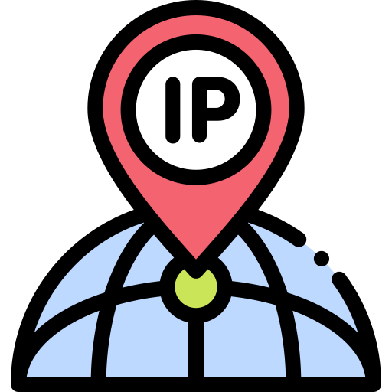
Load Balancer Concepts
A Frontend IP Address is IP Address that is assigned to the load balancer and is used to access the resources being managed by the load balancer.
Frontend IP Address
Backend Pool
Health Probe
Load Balancing Rule

Slide 8

Load Balancer Concepts
A Backend Pool is a pool (group) of resources that are being managed by a load balancer. e.g. VM’s.
Frontend IP Address
Backend Pool
Health Probe
Load Balancing Rule

Slide 9

Load Balancer Concepts
A Health Probe is a special signal that is sent to each resource in the backend pool to check if it’s healthy and available.
Frontend IP Address
Backend Pool
Health Probe
Load Balancing Rule

Slide 10

Load Balancer Concepts
A load balancing rule is used to associate the frontend IP, backend pool and heath probe together.
Frontend IP Address
Backend Pool
Health Probe
Load Balancing Rule

Slide 11
Types of Load Balancers

Slide 12
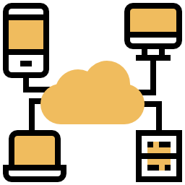
Types of Load Balancers
There are two types of load balancers in your Azure.
1. Internal Load balancer
2. Public Load Balancer

Slide 13
Internal Load Balancer

Slide 14

Internal Load Balancer
An Internal Load Balancer is used to direct traffic only between either Azure’s internal resources i.e. resources managed by the Azure infrastructure or resources connected to Azure infrastructure using a secure VPN.

Slide 15
Hands-on : Create an Internal Load Balancer

Slide 16
Public Load Balancer

Slide 17

Public Load Balancer
A Public Load Balancer is used to handle traffic between a public facing IP address of incoming traffic to private IP addresses of Azure resources.

Slide 18
Hands-on: Create a Public Load Balancer

Slide 19
Troubleshooting Load Balancer

Slide 20

Troubleshooting Load Balancer
There are two reason why you might have to troubleshoot a load balancer.
1. VM’s are not responding to the health probe.
2. VM’s are not responding to the traffic.

Slide 21
VM’s are not responding to the health probe.

Slide 22
VM’s not responding to the health probe
There may be several reasons for this.
VM’s in the backend pool are unhealthy.
VM’s in the backend pool are not listening on the probe port.
The health probe port is blocked by firewall or NSG.
Misconfiguration in Load Balancer

Slide 23
VM’s not responding to the health probe
There may be several reasons for this.
VM’s in the backend pool are unhealthy.
VM’s in the backend pool are not listening on the probe port.
The health probe port is blocked by firewall or NSG.
Misconfiguration in Load Balancer

Slide 24
VM’s not responding to the health probe
There may be several reasons for this.
VM’s in the backend pool are unhealthy.
VM’s in the backend pool are not listening on the probe port.
The health probe port is blocked by firewall or NSG.
Misconfiguration in Load Balancer

Slide 25
VM’s not responding to the health probe
There may be several reasons for this.
VM’s in the backend pool are unhealthy.
VM’s in the backend pool are not listening on the probe port.
The health probe port is blocked by firewall or NSG.
Misconfiguration in Load Balancer

Slide 26
VM’s are not responding to the traffic.

Slide 27
VM’s not responding to the traffic.
There may be several reasons for this.
VM’s in backend pool are not listening on the data port
Data port is being blocked by NSG
Accessing the Load Balancer from the same VM and NIC
Accessing the internal Load Balancer frontend from the participating VM in the same backend pool.

Slide 28
VM’s not responding to the traffic.
There may be several reasons for this.
VM’s in backend pool are not listening on the data port
Data port is being blocked by NSG
Accessing the Load Balancer from the same VM and NIC
Accessing the internal Load Balancer frontend from the participating VM in the same backend pool.

Slide 29
VM’s not responding to the traffic.
There may be several reasons for this.
VM’s in backend pool are not listening on the data port
Data port is being blocked by NSG
Accessing the Load Balancer from the same VM and NIC
Accessing the internal Load Balancer frontend from the participating VM in the same backend pool.

Slide 30
VM’s not responding to the traffic.
There may be several reasons for this.
VM’s in backend pool are not listening on the data port
Data port is being blocked by NSG
Accessing the Load Balancer from the same VM and NIC
Accessing the internal Load Balancer frontend from the participating VM in the same backend pool.

Slide 31
What Is Azure Network Watcher?

Slide 32

What Is Azure Network Watcher?
Azure Network Watcher is a service that contains multiple tools used to diagnose and monitor our Azure Networks.

Slide 33
Azure Network Watcher Features

Slide 34

Azure Network Watcher Features
Network Watcher allows us to monitor traffic between virtual machines and other endpoints. Such as Virtual Machines, URI’s etc.
Monitoring
Diagnostics
Metrics
Logs

Slide 35

Azure Network Watcher Features
Azure Network Watcher allows us to diagnose problems related to filtering, routing, connectivity etc.
Monitoring
Diagnostics
Metrics
Logs

Slide 36
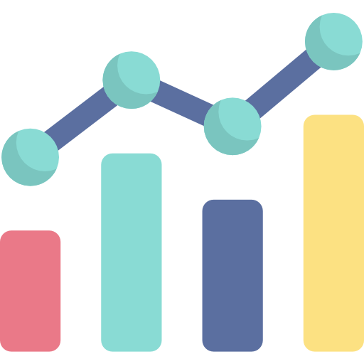
Azure Network Watcher Features
In Network Watcher we can analyze how many of each network resource we have deployed in a region and what the current limit is.
Monitoring
Diagnostics
Metrics
Logs

Slide 37

Azure Network Watcher Features
In Network Watcher we analyze log files for our Network Security Groups and diagnostic logs for network resources.
Monitoring
Diagnostics
Metrics
Logs

Slide 38
Why VPN Gateways?

Slide 39

Why VPN Gateways
A VPN gateway is used to send private encrypted data from one network to another via the public internet.

Slide 40
What is Azure VPN
Gateway?

Slide 41
What is Azure VPN Gateway?
In Azure a VPN Gateway is made up of two or more Virtual Machines
These Virtual Machines are deployed in a special subnet called gateway subnet.
These Virtual Machines are created and configured automatically when we create a VNET Gateway.

Slide 42
Azure Site to Site Connection

Slide 43
Why Site to Site Connection

Slide 44

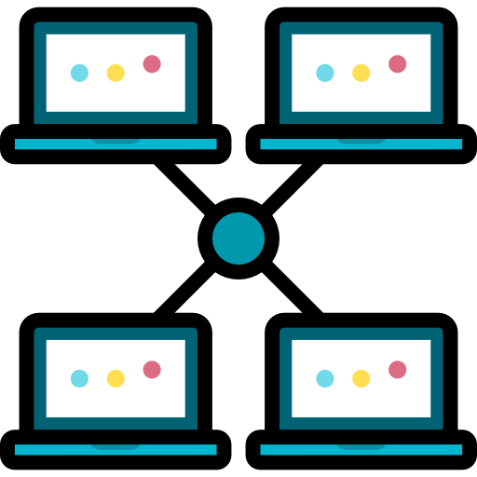
Why Site to Site Connection
Azure Site to Site Connection is used to connect to your On Premise Network to an Azure Virtual Network over the public internet.

Slide 45
What is Site to Site Connection

Slide 46
What is Azure Site to Site Connection
Azure Site to Site Connection allows us to connect and send traffic between our on premises network and an Azure virtual network.
The traffic is sent over the public internet and is encrypted and sent through a VPN Tunnel.
A Site to Site Connection is an ideal solution for connecting on premise network and an Azure Virtual Network if sending encrypted traffic over public internet is not a concern.
Site Connection require a VPN device to be located in the on premise network with a public IP Address.

Slide 47
Hands-on: Set up VPN Gateway Site to Site Connection

Slide 48
Why Azure Express Route

Slide 49

Why Azure Express Route
Azure Express Route enables you to connect your on premises network to Azure Cloud privately with low latency.

Slide 50
What is Azure Express Route

Slide 51

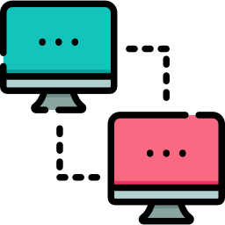
What is Azure Express Route
Microsoft Azure Express Route allows us to connect our on premises network to Microsoft Cloud services like Azure, Office 365 etc. using a private connection established via a connection provider.

Slide 52
Azure Express Route Benefits

Slide 53

Azure Express Route Benefits
Express Route creates a private connections between Microsoft datacenters and infrastructure.
Secure
Fast
Cloud Services
Flexible Billing

Slide 54

Azure Express Route Benefits
Express Route supports bandwidth up to 10Gbps
Secure
Fast
Cloud Services
Flexible Billing

Slide 55

Azure Express Route Benefits
Express Route connections can be used to access:
Microsoft Azure services, Microsoft Office 365 services, Microsoft Dynamics 365
Secure
Fast
Cloud Services
Flexible Billing

Slide 56

Azure Express Route Benefits
Express Route supports the following billing system:
Unlimited data, Metered Data.
Secure
Fast
Cloud Services
Flexible Billing

Slide 57
Azure Express Route Components

Slide 58

Azure Express Route Components
Azure Express Route has two major components.
1. Circuits
2. Peering

Slide 59
Express Route Circuits

Slide 60
Express Route Circuits
An Express Route circuit is a logical connection between your on-premises network and Microsoft cloud services through a connectivity provider.
An Express Route circuit is identified and referenced by a unique identifier called a Service Key.
Each circuit has a fixed bandwidth that is shared by all the network peerings.

Slide 61
Express Route Peerings

Slide 62

Express Route Peerings
A Peering is an connection between two separate networks.
Each Express Route Circuit has three types of peering associated with it: Azure Public, Azure Private and Microsoft Peering

Slide 63
Types of Express Route Peering

Slide 64

Types of Express Route Peering
Private peering is used to connect to Azure compute services like virtual machines, cloud services etc. that are deployed in your VNet.
Private
Microsoft
Public

Slide 65

Types of Express Route Peering
Microsoft Peering is used to connect to Microsoft online services like Office 365, Dynamic 365 etc.
Private
Microsoft
Public

Slide 66

Types of Express Route Peering
Public peering is used to connect to service like Azure Storage, SQL databases, Websites etc. Public peering is deprecated for new circuits and it is advised that you use Microsoft peering in its place.
Private
Microsoft
Public

Slide 67
Quiz

Slide 68
Quiz
1. Which of the following is used by load balancer to check if the resources it's managing are healthy or not?
A
Backend pool
B
Frontend IP
C
Load Balancing Rule
D
Health Probe

Slide 69
Quiz
1. Which of the following is used by load balancer to check if the resources it's managing are healthy or not?
A
Backend pool
B
Frontend IP
C
Load Balancing Rule
D
Health Probe

Slide 70
Quiz
2. Which of the following is used to connect on premise network with Azure over public internet?
A
Site to Site Connection
B
ExpressRoute
C
VNET Peering
D
All of the above

Slide 71
Quiz
2. Which of the following is used to connect on premise network with Azure over public internet?
A
Site to Site Connection
B
ExpressRoute
C
VNET Peering
D
All of the above

Slide 72
Quiz
3. Which of the following is used to connect on premise network with Azure using a private connection?
A
Site to Site Connection
B
ExpressRoute
C
VNET Peering
D
All of the above

Slide 73
Quiz
3. Which of the following is used to connect on premise network with Azure using a private connection?
A
Site to Site Connection
B
ExpressRoute
C
VNET Peering
D
All of the above

Slide 74
Quiz
4. Which of the following ExpressRoute peering types is now deprecated?
A
Private Peering
B
Microsoft Peering
C
Public Peering
D
None of the above

Slide 75
Quiz
4. Which of the following ExpressRoute peering types is now deprecated?
A
Private Peering
B
Microsoft Peering
C
Public Peering
D
None of the above

Slide 76
Quiz
5. ExpressRoute supports bandwidth up to 10Gbps. True or False ?
A
True
B
False

Slide 77
Quiz
5. ExpressRoute supports bandwidth up to 10Gbps. True or False ?
A
True
B
False

Slide 78
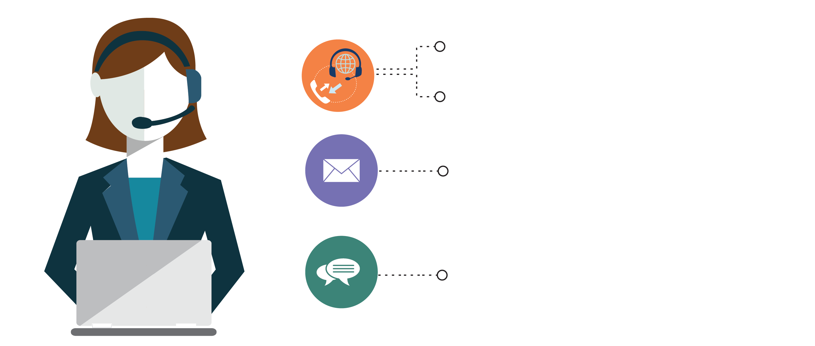
India: +91-7847955955
US: 1-800-216-8930 (TOLL FREE)
support@intellipaat.com
24/7 Chat with Our Course Advisor
Notes:
Thank you!

